Slide 1
CALCULUS PROJECT SC107 (FALL 2023): DIWALI PROJECT

Slide 2
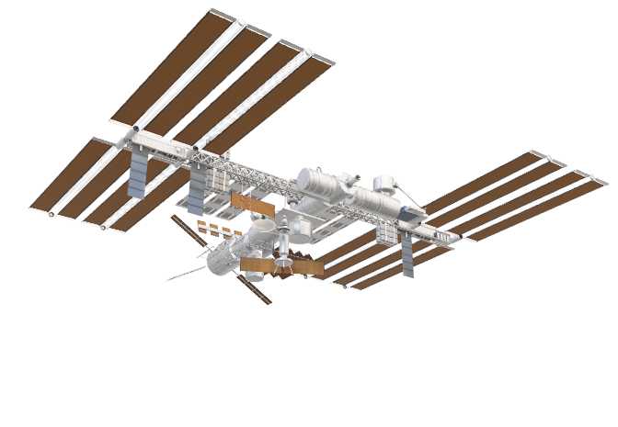
TOPIC : ORBITAL DECAY & SATELLITE MAINTANACE

Slide 3
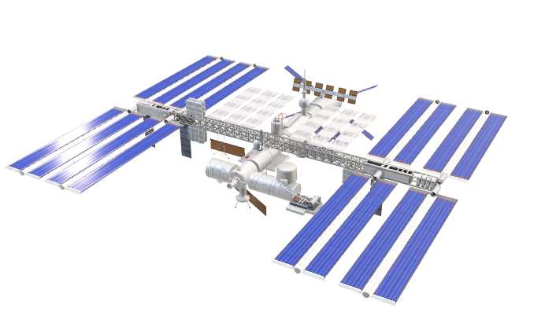
What is orbital decay?
Orbital Decay refers to the gradual decrease in the altitude or size of an object’s orbit around a celestial body.
This phenomenon occurs when external forces act on the object such as gravitational perturbations from other celestial bodies, radiation pressure, and tidal forces. These forces results in loss of energy, causing the object to move to a lower orbit over time.
Engineers and scientists account for these factors when planning the trajectories of satellites and other objects in space to prevent collisions or re-entry into the atmosphere.

Slide 4
Atmospheric Drag
Atmospheric Drag also known as aerodynamic drag is a force exerted by the Earth’s atmosphere on objects moving through it.
Mechanism: Even in the near-vacuum of space, there are still trace amounts of atmosphere. As a satellite orbits the Earth, it encounters these atmospheric particles, causing a drag force.
Effect: This drag gradually decreases the satellite's orbital energy and altitude over time.

Slide 5
Orbital Parameter
Low Earth Orbit (LEO): Satellites in LEO are more affected by atmospheric drag due to their proximity to Earth. Consequently, LEO satellites have shorter lifespans and require more frequent adjustments.
Geostationary Orbit (GEO): Satellites in GEO experience minimal atmospheric drag, so their orbits are more stable over a longer period.

Slide 6
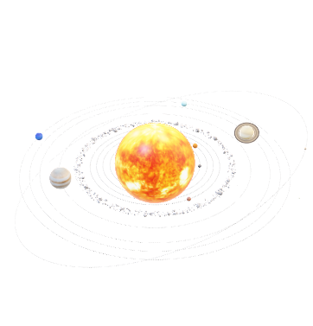
Mitigation Strategies
Propellant Management: Satellites carry onboard propulsion systems and fuel. Periodic burns can counteract the effects of atmospheric drag, restoring the satellite to its intended orbit.
End-of-Life Maneuvers: When a satellite nears the end of its operational life, controlled deorbit maneuvers can be executed to guide it safely into Earth's atmosphere, where it will burn up.

Slide 7


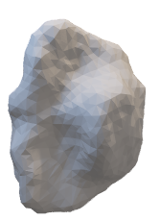
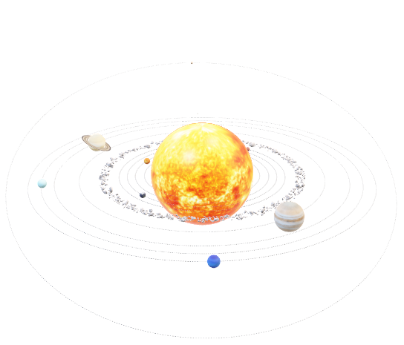
Natural Factors
Solar Activity: Variations in solar activity can impact the density of the Earth's upper atmosphere, influencing the rate of orbital decay.

Slide 8
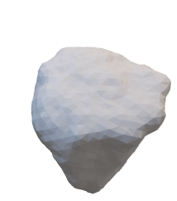
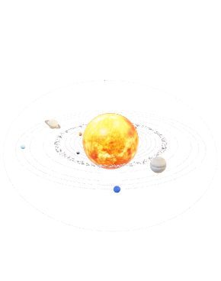

SPACE DEBRIS
Collision Risks: Orbital decay can bring satellites closer to other space objects, increasing the risk of collisions. This highlights the importance of space debris management and collision avoidance strategies.

Slide 9
SATELLITE MAINTANANCE
Power Management :
Power management is an important aspect of satellite operations, confirming that a satellite has a stable and reliable power supply for its various systems and instruments. Satellites typically rely on solar power generated by solar panels, and efficient power management is essential to optimize energy usage and extend the life of the satellite.

Slide 10
REDUNDANCY
Systems: Satellites are equipped with redundant systems and components. If a primary system fails, the satellite can switch to backups, prolonging its operational life.

Slide 11
SOFTWARE UPDATES
Ground Control: Operators on the ground can send software updates to satellites, addressing bugs, improving performance, or adapting to changing mission requirements.

Slide 12
COLLISION AVOIDANCE
Orbital Monitoring: Satellite operators continuously monitor the orbital environment for potential collisions with space debris or other satellites. When a collision risk is identified, operators can execute maneuvers to avoid it.

Slide 13
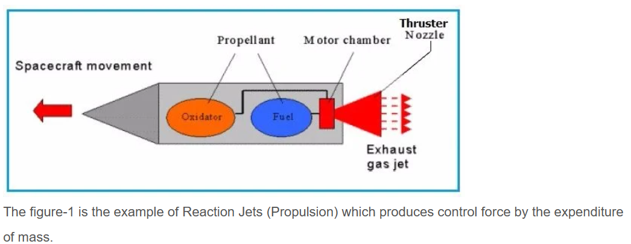
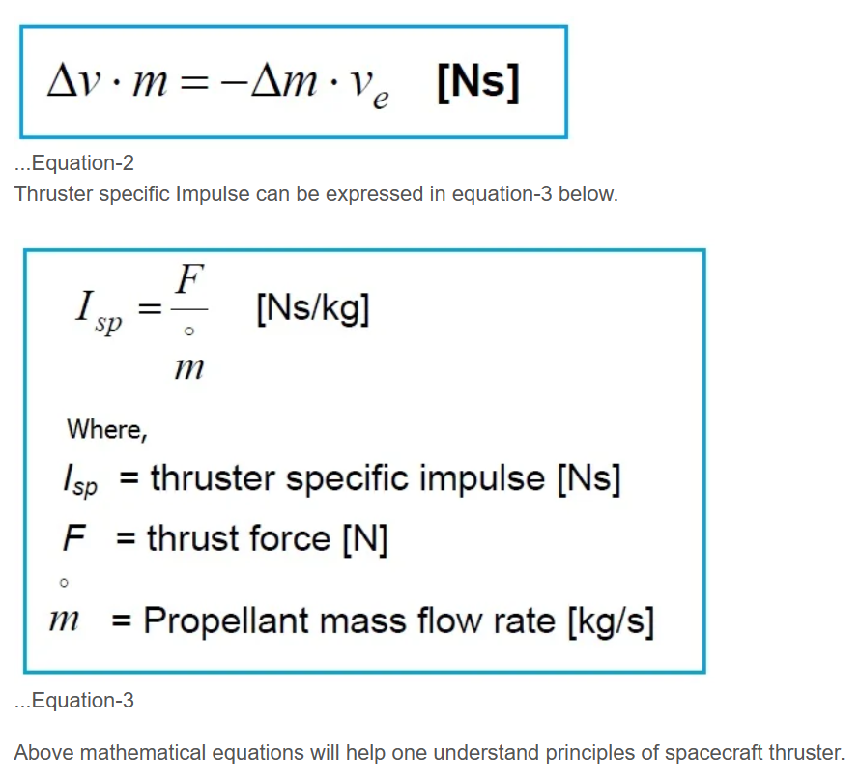
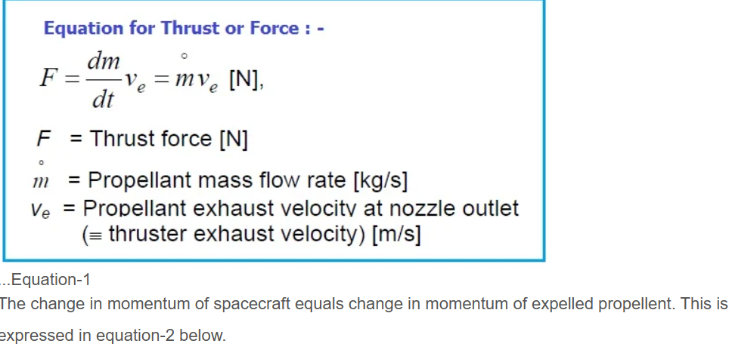
FUEL MANAGEMENT
Thrusters: Satellites may have thrusters for orbital maneuvers. Proper fuel management is crucial for executing these maneuvers and extending the satellite's operational life.

Slide 14
END OF LIFE PLANNING
Deorbit Maneuvers: Once a satellite reaches the end of its mission life, operators plan controlled deorbit maneuvers to safely remove the satellite from orbit, reducing the risk of contributing to space debris.

Slide 15
COMMUNICATION SYSTEMS
Transponders: Regular checks on communication transponders and systems ensure that the satellite can continue to send and receive signals effectively.

Slide 16
HEALTH MONITORING
Both orbital decay and satellite maintenance are critical considerations in space operations. Effective maintenance practices help maximize the utility of satellites, while strategies to mitigate orbital decay contribute to long-term space sustainability.
Telemetry Data: Operators continuously receive telemetry data from satellites, allowing them to assess the health of various subsystems and identify potential issues.

